Slide 1
2020 FaceBase Users Bootcamp
Cris Williams, Robert Schuler, Alejandro Bugacov
FaceBase Hub
November 18, 2020
Notes:
Goals for this talk:
Increase your awareness of FaceBase and its resources to aid you in your research
Invite you to consider sharing/contributing your research data through FaceBase

Slide 2
Agenda
Welcome and Introductions
Walkthrough of facebase.org
Detailed tour of the Data Browser and how to find data
  How data is organized
  How to filter through data
  How to share and cite
Exporting data
Brief overview of how to submit data
Requesting access to human data
Question and Answer

Slide 3
An Open Platform for Craniofacial and Dental Research
Comprehensive resource on dental and craniofacial research -- fostering data sharing and curated resources.
Comprised of a core team of craniofacial and computer science expertise w/ advisory and experts groups for oversight.
Transitioned from a “hub and spoke” consortium to a community-wide effort in 2019.

Slide 4
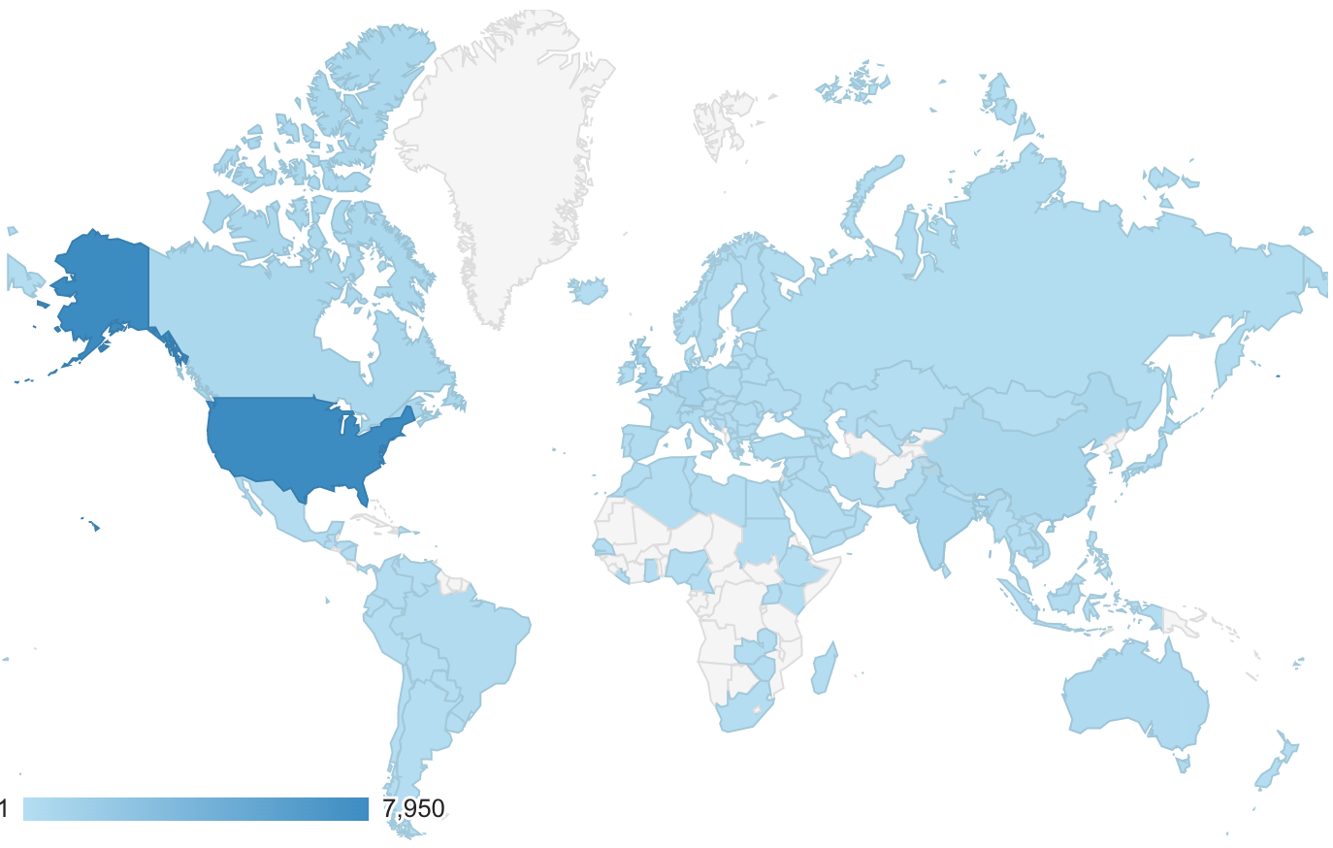
Growing, Multi-faceted Digital Repository
942 Datasets and growing
820 mouse, 82 human, 39
zebrafish, 3 other
634 imaging, 143 sequencing,
and other experiment types
800+ detailed experiment records
3,500~ detailed biosample records
5,000+ images, 3,700+ sequencing, 2,270+ tracks, and more (~10 TB)
12 Month Usage
16,000+ visitors, 63,900~ views
2,000+ downloads
7,400+ image views
77,000+ track reads
13 new projects contributing data from FB3:Y1
Serves a worldwide community:
50% US + 50% International (traffic)

Slide 5
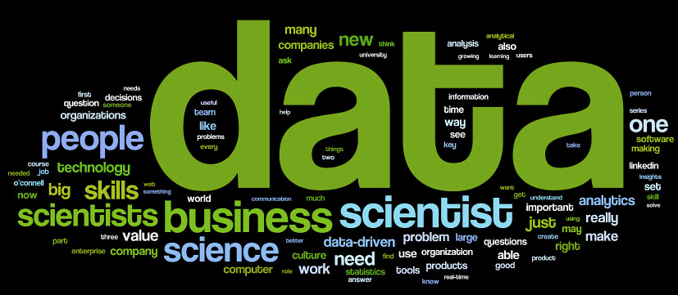
Mission to Improve the Stewardship of Research Data
Science is dependent on generating and analyzing data, but…
80% of time spent on accessing, cleaning, integrating data
Scarcity of data sharing
10% reproducibility of data
Recent high-profile retractions in COVID-19 research, for example.

Slide 6

Findable Accessible Interoperable Reusable Data
Organization of data files to understand what and how they were produced
Terminology from community standards with broad acceptance
Description of the experimental methods and biological materials
Protocols that are enumerated or referenced for precise details
This Photo by Unknown Author is licensed under CC BY-SA-NC

